Slide 1


Global Kitchen
INFO 6350 Smartphones-Based Web Development Final Project
Project By :
Nagarjun Mallesh

Slide 2
Introduction
As a passionate food enthusiast and an international student with a love for cooking, I have often found myself struggling to keep track of my favorite recipes. Whether it's a cherished family recipe shared by my mother or an exciting new dish discovered online, the process of organizing and managing these culinary gems has always been a challenge.
This personal struggle inspired me to develop the Recipe Management System—an iOS application designed to revolutionize the way food lovers like myself manage their recipe collections.
This application seeks to bridge that gap by offering a seamless and intuitive platform that simplifies recipe management, making it easier for users to access and utilize their favorite recipes whenever the craving strikes.
One of the key features of the Recipe Management System is its ability to store recipes locally on the user's smartphone.
Global Kitchen offers a range of powerful features designed to enhance the user experience. Users can easily add their own recipes, edit existing ones, and even delete recipes they no longer need. The application also includes a favorites feature, allowing users to mark their most beloved recipes for quick access.

Slide 3
Design / Approach
Swift UI : Modern framework for building iOS user interfaces
Modular architecture:
Feature-Based Modular Architecture: In a feature-based modular architecture, the application is organized into modules based on specific features or functional areas.
Core Module: Contains the core functionality and foundation of the application.
Recipe Module: Encapsulates all the components, views, and models related to the recipe feature.
Authentication: User account creation and login using Firebase Authentication
Model : Contains the Recipe and Category models, which define the structure and properties of recipes and categories, respectively. Encapsulates the core data entities and their relationships
Data Persistence and Authentication : Firebase Authentication is used to handle user authentication and secure access to user-specific data.

Slide 4
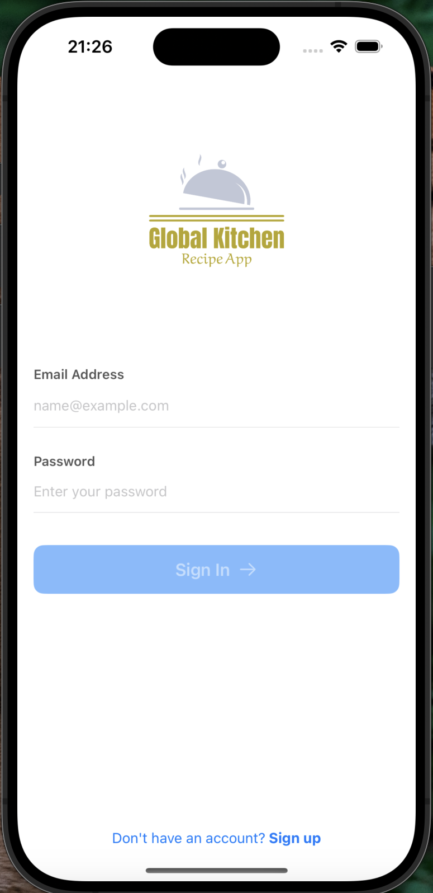
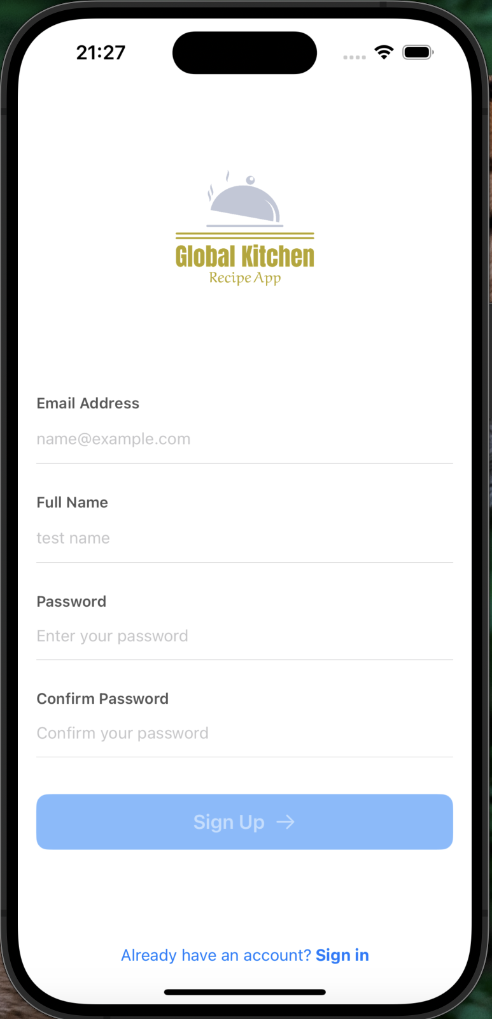
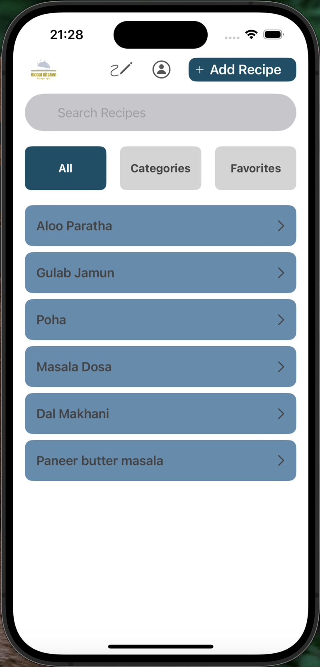
Screenshots
Login Page
Register Page
Recipe Home Page

Slide 5
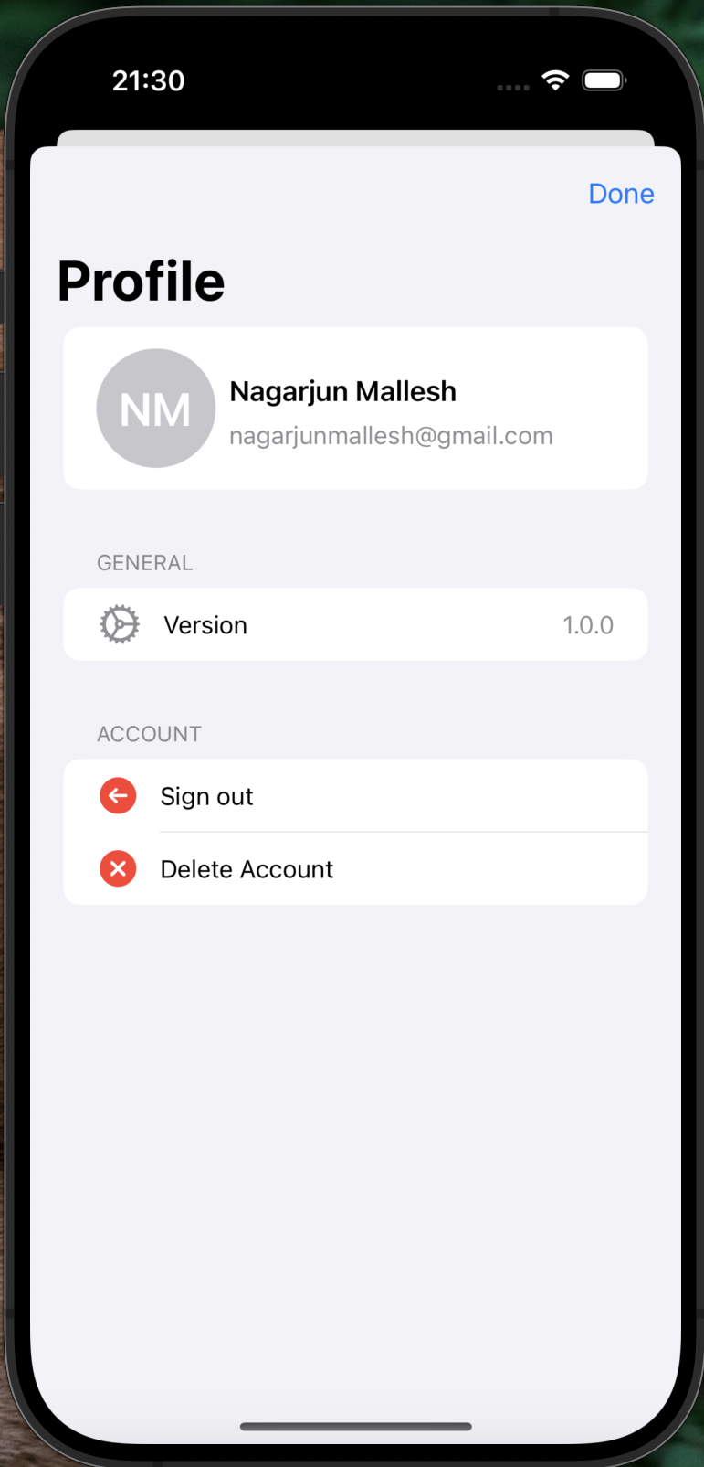
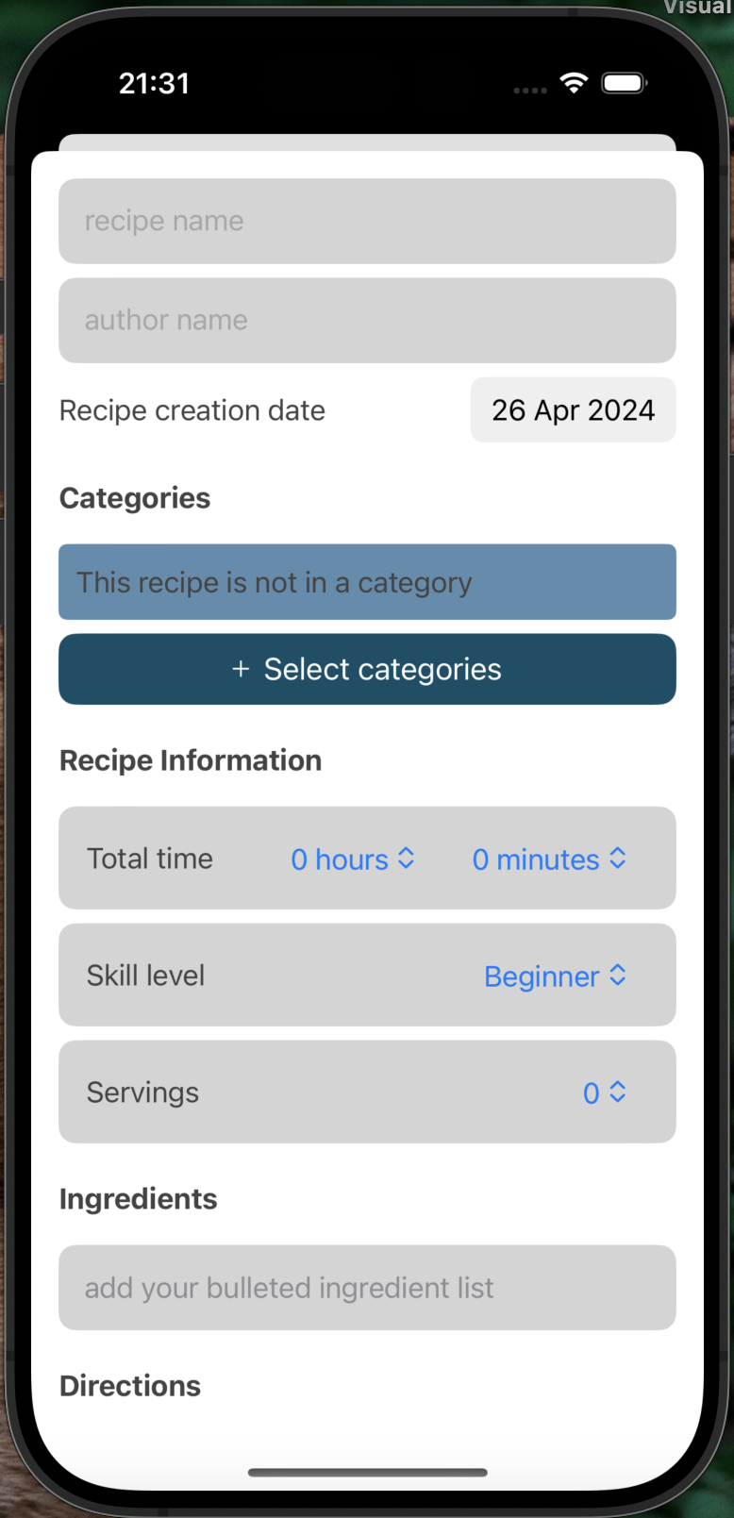
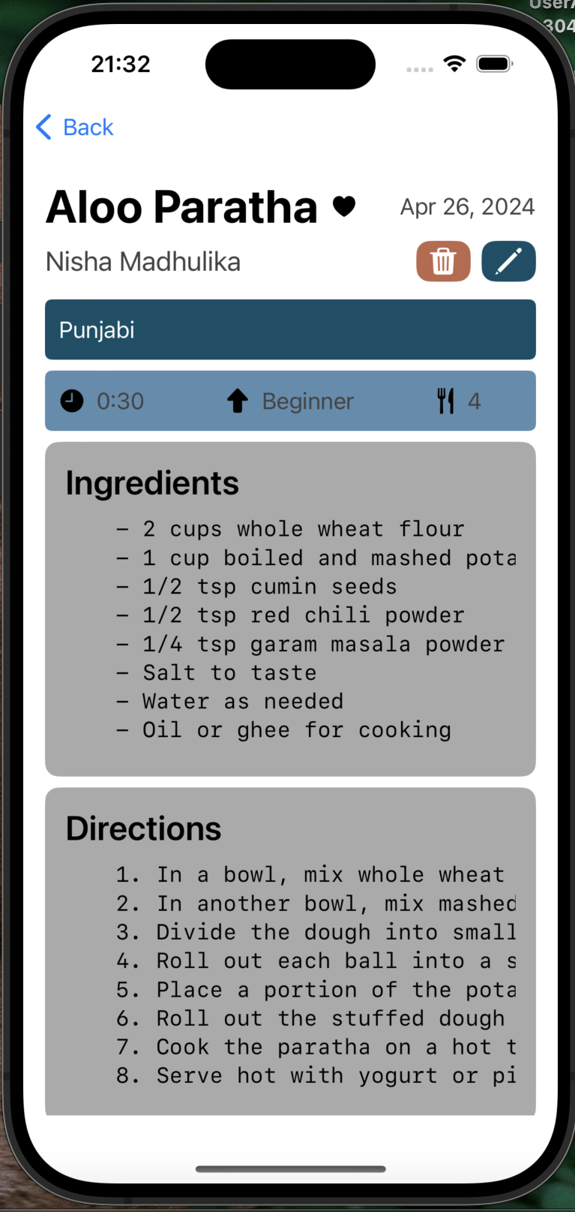
Screenshots
User Profile Page
Create New Recipe Page
Recipe View Page

Slide 6

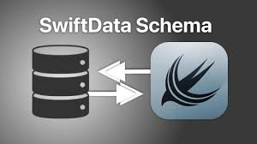


Techniques/Highlights
Swift UI: Declarative syntax and powerful composition for dynamic and interactive views
Firebase Authentication: Secure user authentication and management
Firebase Firestore: Scalable NoSQL database for storing and retrieving data
SwiftData: Local data persistence for offline access and fast performance
Markdown Support: Enhances readability and usability of recipe content
Asynchronous Data Fetching: Ensures smooth user experience and responsiveness

Slide 7
Conclusion and Future Work
The Recipe Management System provides a solid foundation for managing recipes effectively.
User-friendly interface, powerful features, and integration with modern technologies simplify recipe management.
Swift UI, Firebase, and modular architecture offer robustness and scalability.
Potential to become an all-in-one platform for recipe management, meal planning, and social sharing.
Empowers users to explore culinary passions, save time, and create delightful meals.
Future improvements:
User Profiles for personalization and sharing.
Social Sharing to connect with fellow food enthusiasts.
Meal Planning for efficient meal preparation.
Image Support to enhance visual appeal.
Recipe Scaling for adapting recipes to different serving sizes.

